Slide 1
“Augmented Reality App for Education purposes”
Batch Members
V Gopinath : 2GI19IS056
Vishwas Dinni : 2GI19IS063
Madhushri Kulkarni : 2GI19IS064
Under the Guidance of
Prof Pandurang S. Upparamani
Department of Information Science and Engineering
KLS, GIT, Belgaum
Academic Year – 2022-23

Slide 2

Augmented Reality
A combination of a real scene viewed by a user and a virtual scene generated by a computer that augments the scene with additional information.

Slide 3
Introduction
Project Title:
Augmented Reality App for Educational purposes: An Interactive Digital Augmented reality App for Learning About objects in the 3d environment .
Objectives:
The primary objective of this project is to develop a marker-based AR technology that provides an immersive and interactive learning experience for users of all ages.
The outcome of this project will be a fully functional Augmented reality App using marker-based AR technology that provides an engaging and interactive learning experience about various things about a particular image target.

Slide 4
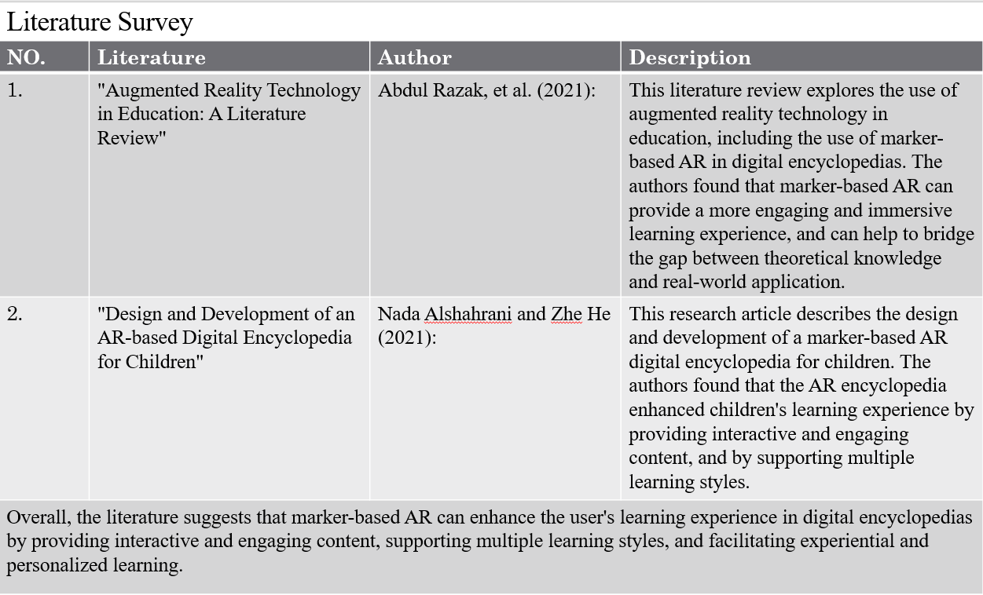
Literature survey

Slide 5
Marker Based-AR
AR Book using marker-based AR typically involves a physical book or a set of cards with markers that trigger the AR content.
By pointing their device's camera at a specific page or image within the book or card, the user can access additional educational content and graphics in real-time.
For example, the user may see a three-dimensional (3D) animated model of a dinosaur on their screen, which they can interact with and learn about its features, behaviors, and habitats.

Slide 6
Requirement Specifications:
Functional requirements:
The application must display 3D models, images related to different objects when the user scans the corresponding marker.
The application should provide educational and informative content about the different types of objects based on the marker.
The application must be compatible with a range of mobile devices, such as iOS and Android smartphones and tablets.
Non-functional Requirements:
The application must be responsive and have a fast loading time for the AR content related to the dinosaurs.
The application should be compatible with different versions of mobile operating systems, as well as desktop operating systems.

Slide 7
Software Platforms and Development Tools Identified
Programming Language: C#
Operating system: Windows or Mac OS
Mobile platforms: Android, Iphone
Development IDE: Unity
Unity AR is a platform for creating Augmented Reality (AR) applications using the Unity game engine. Unity AR, developers can create AR experiences that combine the physical and virtual worlds, enabling users to interact with digital content in real-time. Unity AR provides a set of tools and APIs for creating AR applications, including support for various AR frameworks such as ARKit, ARCore, Vuforia, and EasyAR.
Development Kit(SDK): Vuforia Engine
Vuforia engine is a popular AR platform that provides tools and APIs for building marker-based AR applications for various platforms such as iOS, Android, and Unity. Vuforia supports various types of markers, including QR codes, image targets, and multi-targets, which allow developers to create complex AR experiences that involve multiple markers.

Slide 8

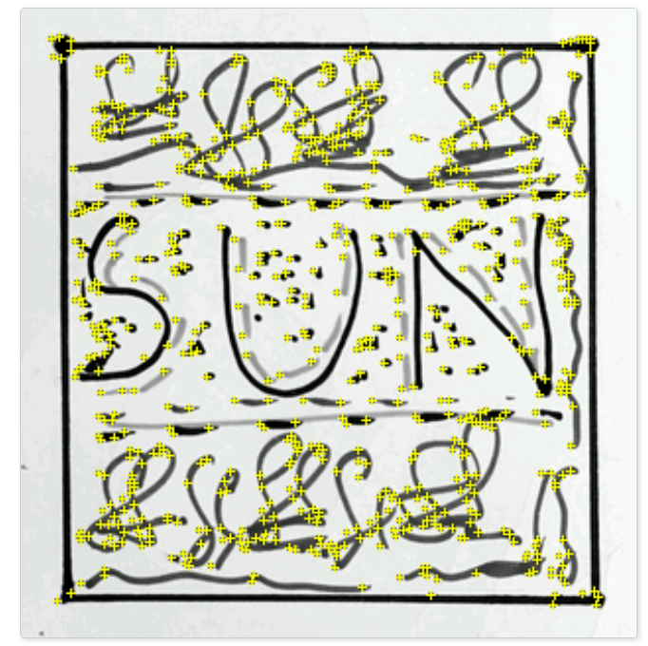
Marker Identification points
Tracking Points

Slide 9
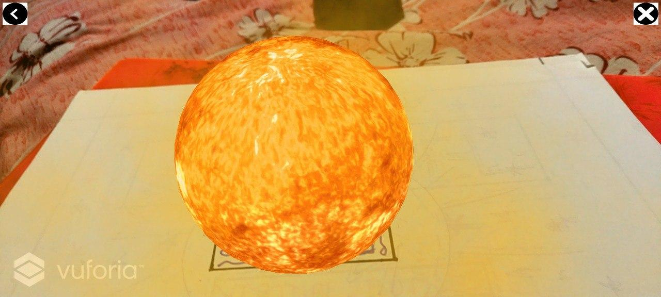
AR Scene

Slide 10
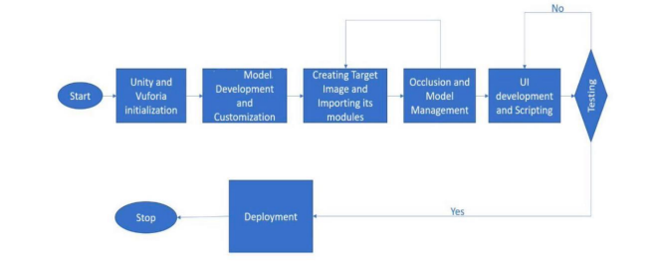
BLOCK DIAGRAM

Slide 11
Methodology
Define learning Objectives
Content Design and Development
Marker Selection and Creation
AR Experience Integration
User Interface Design
Testing and Debugging
Evaluation and Assessment
Integration with AR Plugin
Mobile Platform Optimization

Slide 12
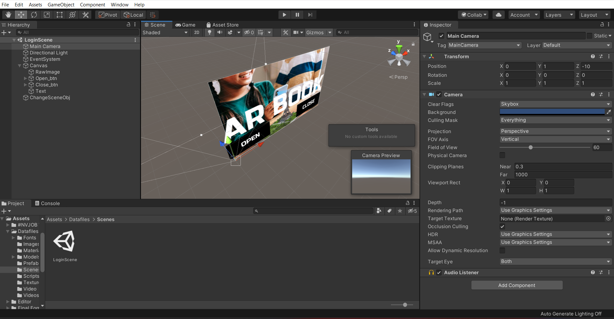
Unity Editor Environment

Slide 13
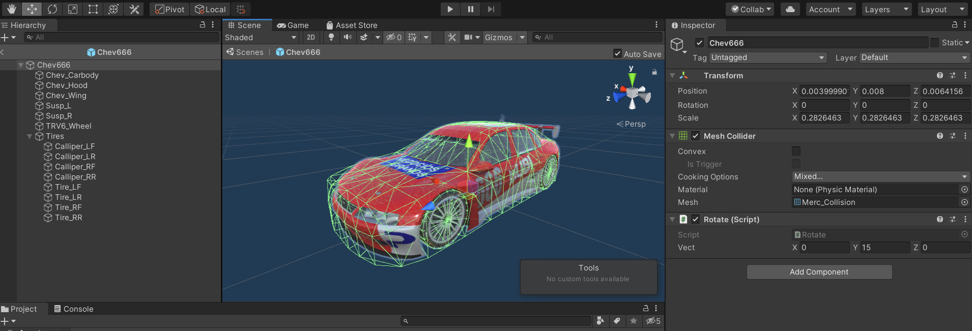
Development of the Model in the Unity Editor

Slide 14
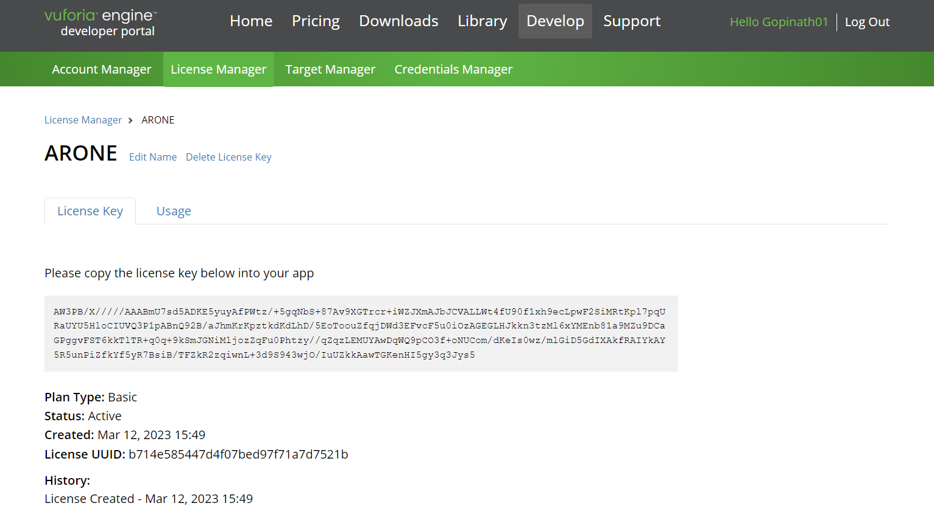
Vuforia Engine Developer Portal

Slide 15
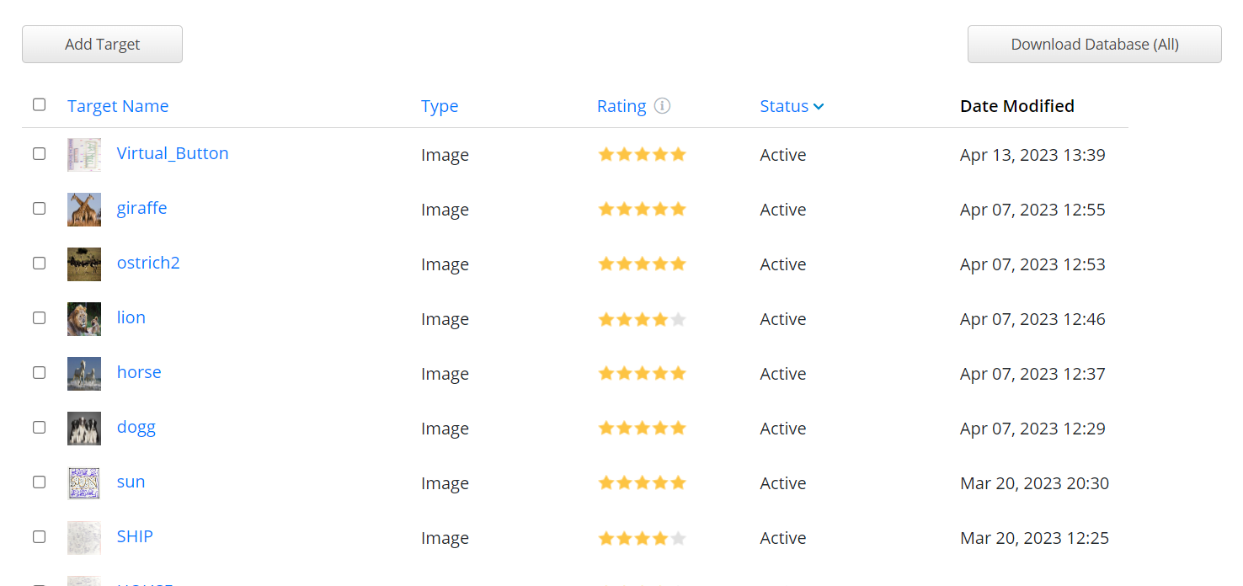
Vuforia Engine Database

Slide 16
References:
1, "AR-ENCYCLOPEDIA: A Marker-Based Augmented Reality Application for Learning Science" by C. David et al. (2017)
Link: https://ieeexplore.ieee.org/document/8121543
2. "ARpedia: A Marker-based Augmented Reality Application for Educational Purposes" by N. Mustapha et al. (2017)
Link: https://ieeexplore.ieee.org/document/8026956
3. "Interactive AR Encyclopedia: An Augmented Reality Application for Education" by R. Mohamad et al. (2019)
Link: https://ieeexplore.ieee.org/document/8915354
4. "Augmented Reality Encyclopedia: A Marker-Based Approach to Learning" by M. Hussein et al. (2018)
Link: https://link.springer.com/chapter/10.1007/978-3-319-92378-2_37

Slide 17
THANK YOU!!!

